Slide 1
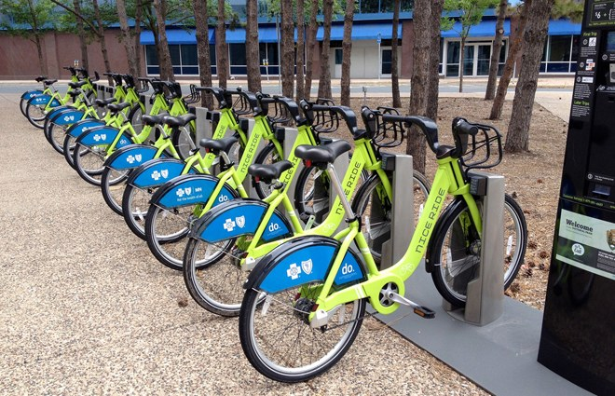
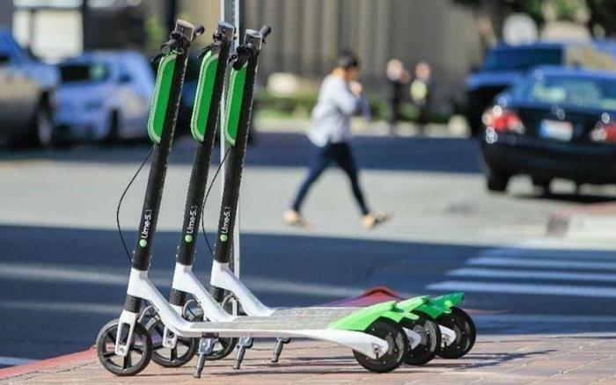
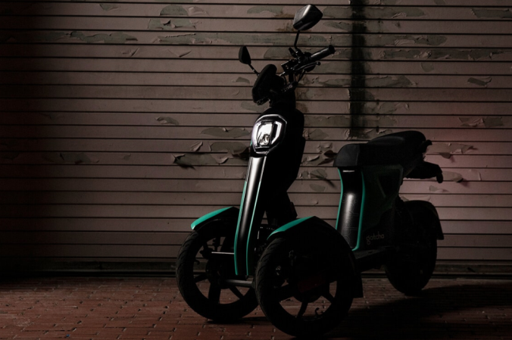
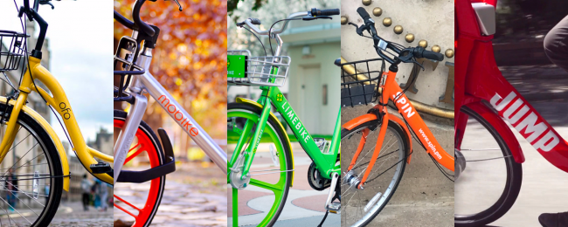
Is a Bikeshare or eScooter-share System Right for Your Community?
Dock-based bikeshare
e-Scooters
John Landosky, Ph.D.
City of Little Rock Bicycle and Pedestrian Coordinator
August 15, 2019
Dockless bikeshare
…this thing

Slide 2
Outline
What is Shared Micromobility?
  Not bike rental
  Brief history
Why shared micromobility?
Differences among systems and providers
Is my community ready for shared micromobility?

Slide 3
What is shared Micromobility?

Slide 4
Shared Micromobility
Equipment: bike, scooter other
Located

Slide 5
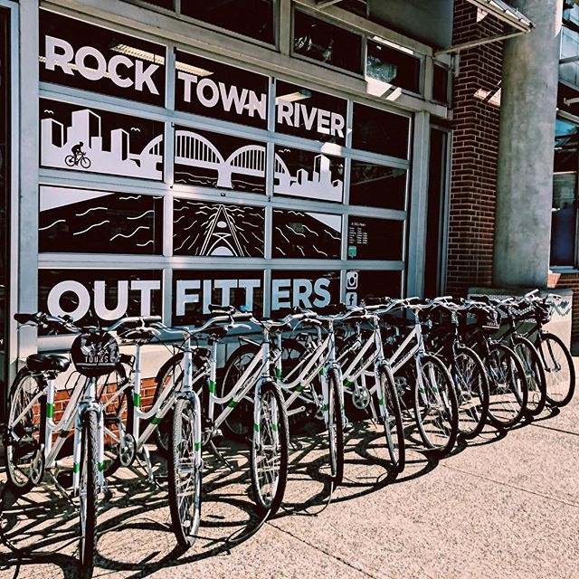
…Not Bike Rental
For bike rental, you walk into a brick and mortar shop

Slide 6
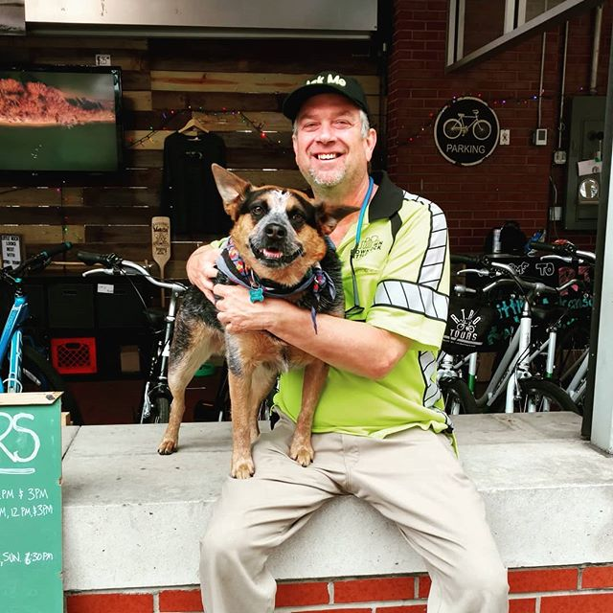
Bike Rental
Talk to a person

Slide 7
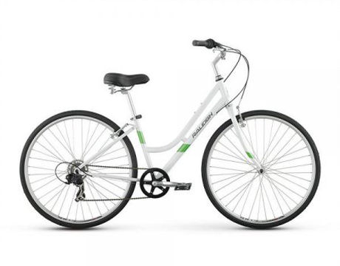
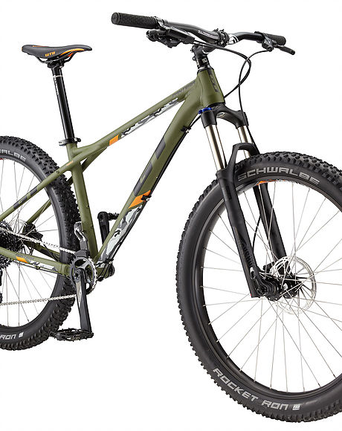
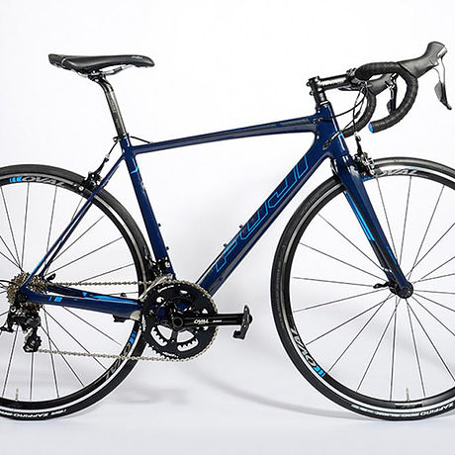
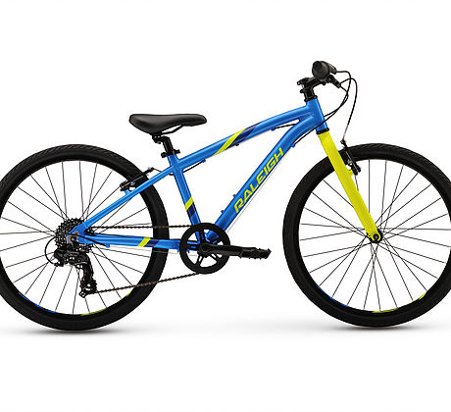
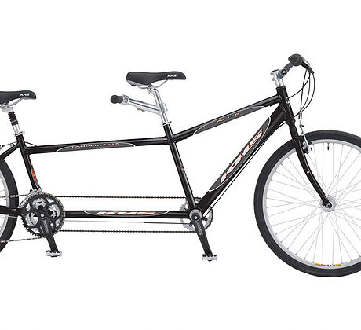
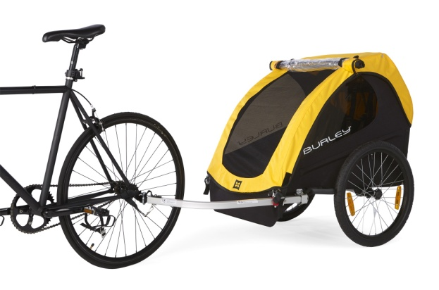
Bike Rental
Comfort Hybrid
Mountain Bike
Road Bike
Junior Bike
Tandem
Trailer
Choose from a variety of bike types

Slide 8

Bike Rental
Rent for several hours

Slide 9
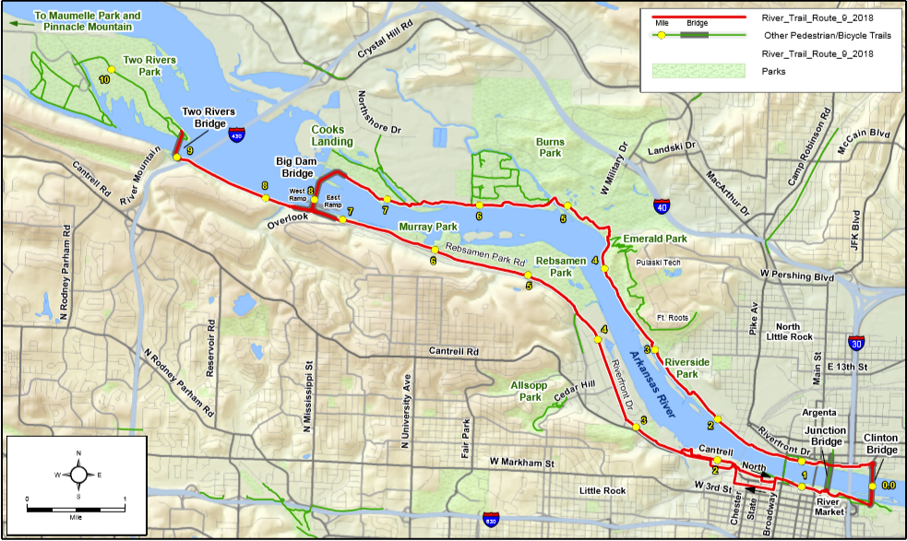
Bike Rental
Ride for recreation/exercise

Slide 10
Bike Rental
Return to the brick and mortar shop
(i.e. round trip)

Slide 11
Bike Rental
Check in with the nice store clerk.
Pet the dog.

Slide 12
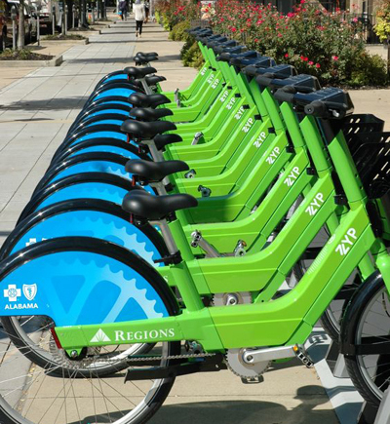
Shared Micromobility, e.g. Bikeshare
Check out bike remotely

Slide 13
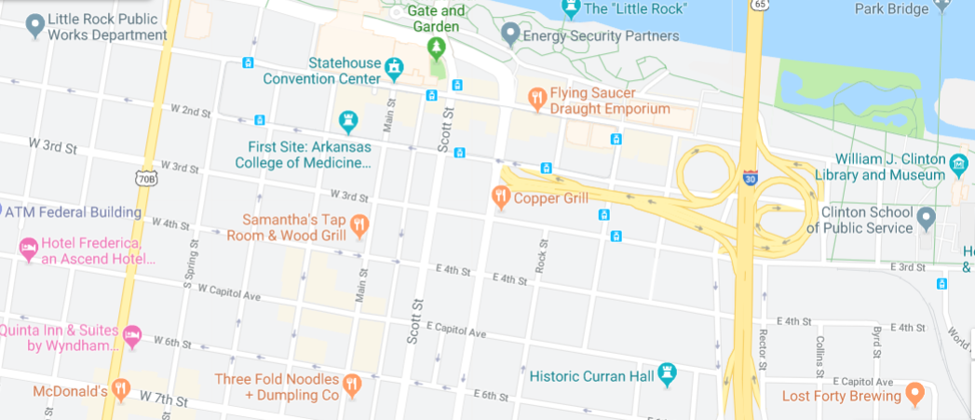
Bikeshare
One-way, short ride
Ride for transportation
Typically on-street (to get from origin to destination)

Slide 14
Bikeshare
Check in bike remotely

Slide 15
Shared Micromobility vs. Bike Rental
Bike Rental
Shared Micromobility (e.g. bikeshare)
Rent from shop
Bike choice
Several hours
Recreation
Trails or streets
Round trip
Check out remotely
  Dock-based: from a station
  Dockless: anywhere
One bike type
Average trip 15-20 minutes
Transportation
Ride on street network
One way

Slide 16
Shared mobility
A brief history

Slide 17
Timeline
Smartbike DC
120 bike pilot
First modern U.S. bikeshare
Bikeabout
Portsmith University, UK
Magnetic Stripes
Accountability
Velo ‘v
Lyon, France
1500 bikes
1960
2020
1960’s
1970’s
1980’s
1990’s
2000’s
2010’s
Witte Fietsen
Amsterdam
honor system
Theft and vandalism
Velib
Paris France
1500 bikes
Free Riders
Copenhagen
Coin-operated
Theft and vandalism
Hangzhou, China
2,800 bikes
Velo a la Carte
Rennes France
Magnetic Stripes
200 bikes

Slide 18
United States Timeline*
B-Cycle
Denver, CO
Divvy
Chicago, IL
Capitol Bikeshare
Washington DC
2010
2011
2012
2013
2014
2015
2016
2017
2018
2019
Nice Ride
Minneapolis, MN
Hubway (now BLUEbikes)
Boston, MA
* Abridged consideration of bikeshare systems

Slide 19
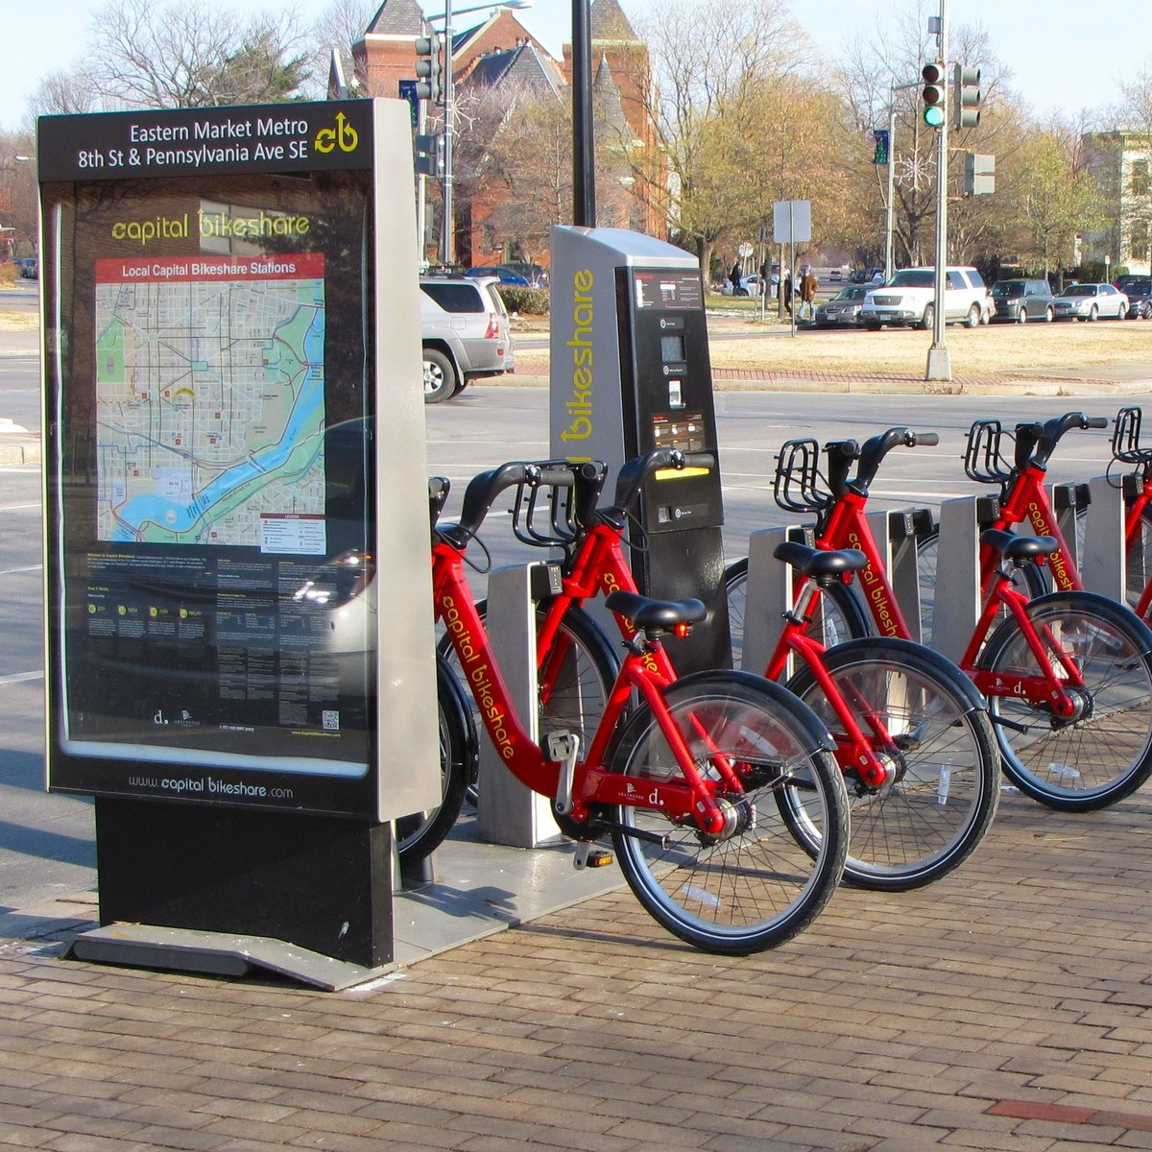
Dock-Based Bikeshare
Millions of $$
  Municipality
  Fed grant
Big city solution
Tech in dock
Bikes sturdy but heavy

Slide 20
United States Timeline
B-Cycle
Denver, CO
Divvy
Chicago, IL
Capitol Bikeshare
Washington DC
2010
2011
2012
2013
2014
2015
2016
2017
2018
2019
Nice Ride
Minneapolis, MN
Citi Bike
New York, NY
Hubway (now BLUEbikes)
Boston, MA

Slide 21
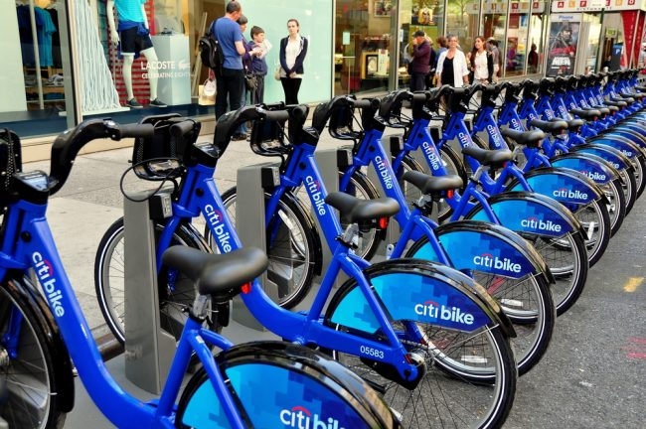
Corporate Sponsored Bikeshare
Cost a major hurdle
Sponsorship makes achievable
Still
  tech in dock
  bikes sturdy but heavy

Slide 22
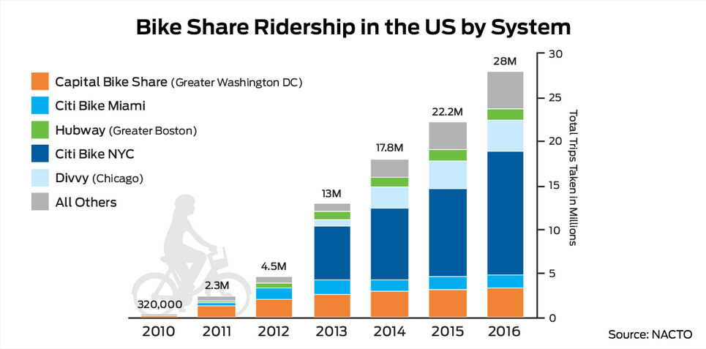

Slide 23
United States Timeline
2014
Major, interested markets tapped
Expansion required a business model possible for
  smaller cities
  universities
B-Cycle
Denver, CO
Divvy
Chicago, IL
Capitol Bikeshare
Washington DC
2010
2011
2012
2013
2014
2015
2016
2017
2018
2019
Nice Ride
Minneapolis, MN
Citi Bike
New York, NY
Hubway (now BLUEbikes)
Boston, MA
Citi Bike
Miami, FL

Slide 24

Smart Bikes
Tech on bikes not stations
  cheaper
Can use standard bike racks
Business model
  Free for universities/municipalities
  Requires local corporate sponsorship to be sustainable

Slide 25
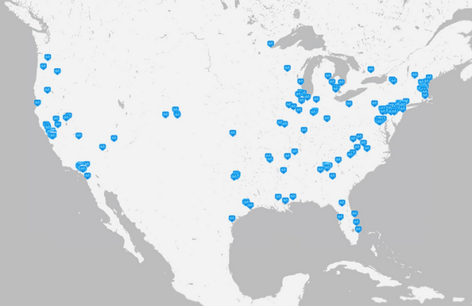
Zagster Universities/Cities

Slide 26
Many communities, but marketshare a portion of the gray bar

Slide 27
United States Timeline
B-Cycle
Denver, CO
Market
Disruption
Divvy
Chicago, IL
Capitol Bikeshare
Washington DC
Small ball
2010
2011
2012
2013
2014
2015
2016
2017
2018
2019
Nice Ride
Minneapolis, MN
Citi Bike
New York, NY
Citi Bike
Miami, FL
Hubway (now BLUEbikes)
Boston, MA

Slide 28
United States Timeline
B-Cycle
Denver, CO
2017
Dockless
Bikeshare Boom
Divvy
Chicago, IL
Capitol Bikeshare
Washington DC
Small ball
2010
2011
2012
2013
2014
2015
2016
2017
2018
2019
Nice Ride
Minneapolis, MN
Citi Bike
New York, NY
Citi Bike
Miami, FL
Hubway (now BLUEbikes)
Boston, MA

Slide 29
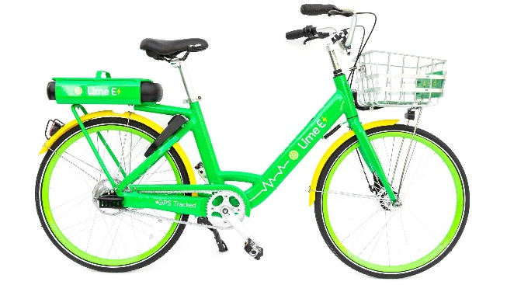
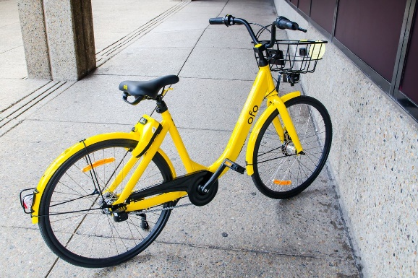
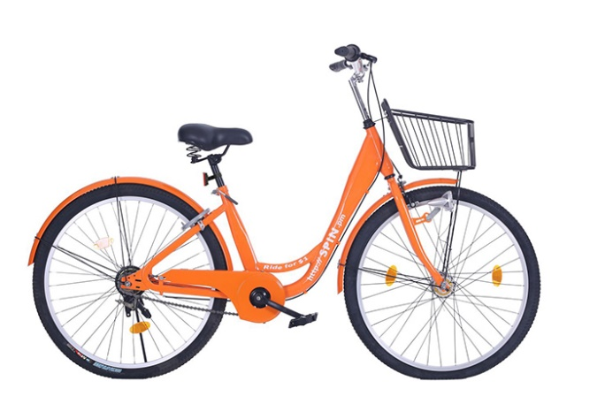
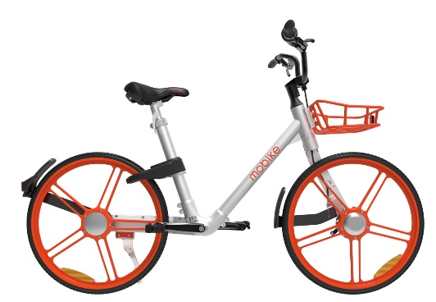
Dockless Bikeshare
Wave of the future!...?
No bikeshare stations
  Find a bike wherever
  Return wherever
Business model
  No cost to municipalities
  No corporate sponsorships required
    No lag for implementation
Lime
Ofo
Spin
Mobike

Slide 30
But then… dockless problems

Slide 31
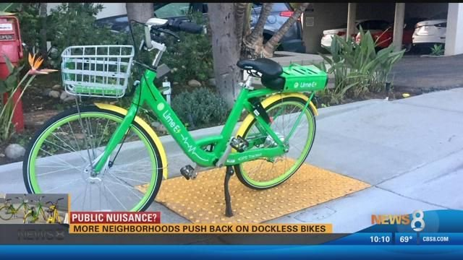
Everywhere means anywhere…
Pedestrian walkways
ADA ramps
Blocking entrances/exits
In the river…
Dockless nature can be a problem

Slide 32
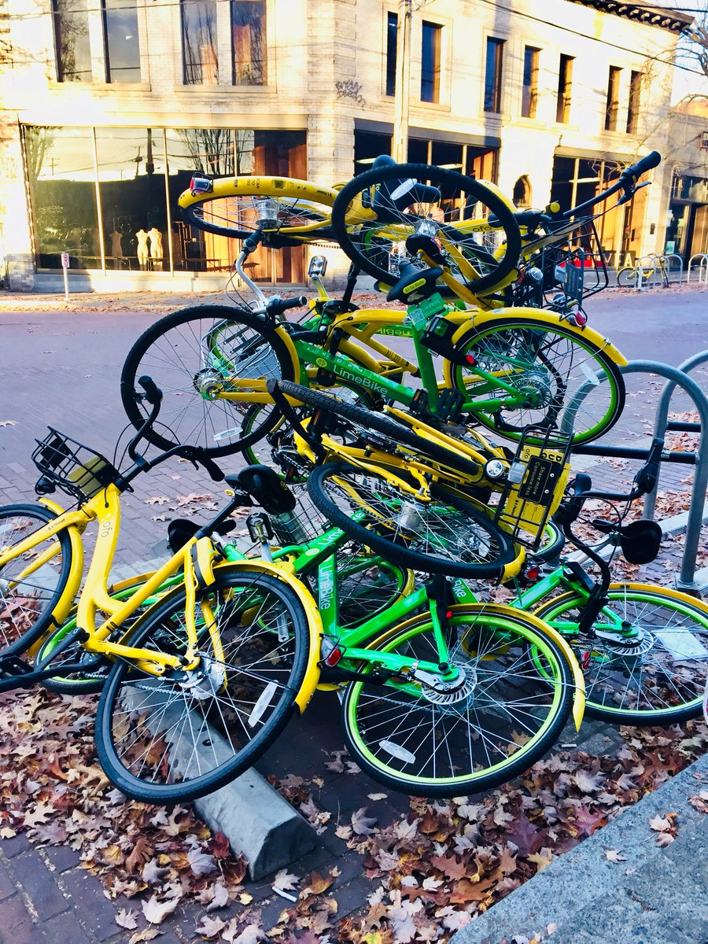
Clutter…
Clutter
  bike locations less predictable with dockless
  need several times more bikes to make work
Bike litter

Slide 33
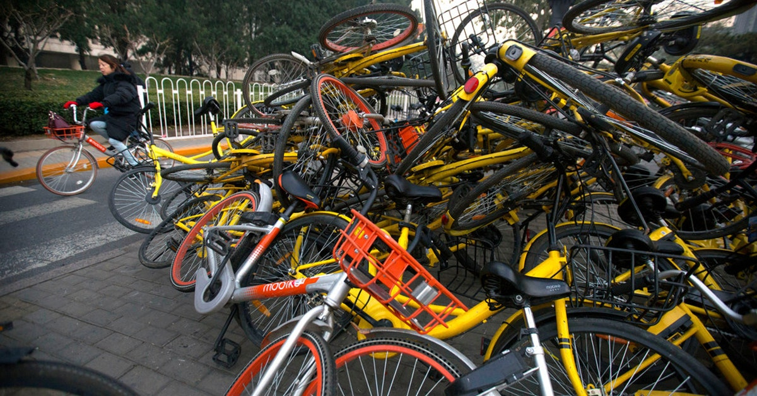
It’s a Dockless Party! Everyone’s Invited!
Municipalities
  Quick, Easy, & Free?
  Fair
  No RFP process required
Doors wide open
Need a minimum density for each vendor
Severe clutter
e.g. Dallas

Slide 34
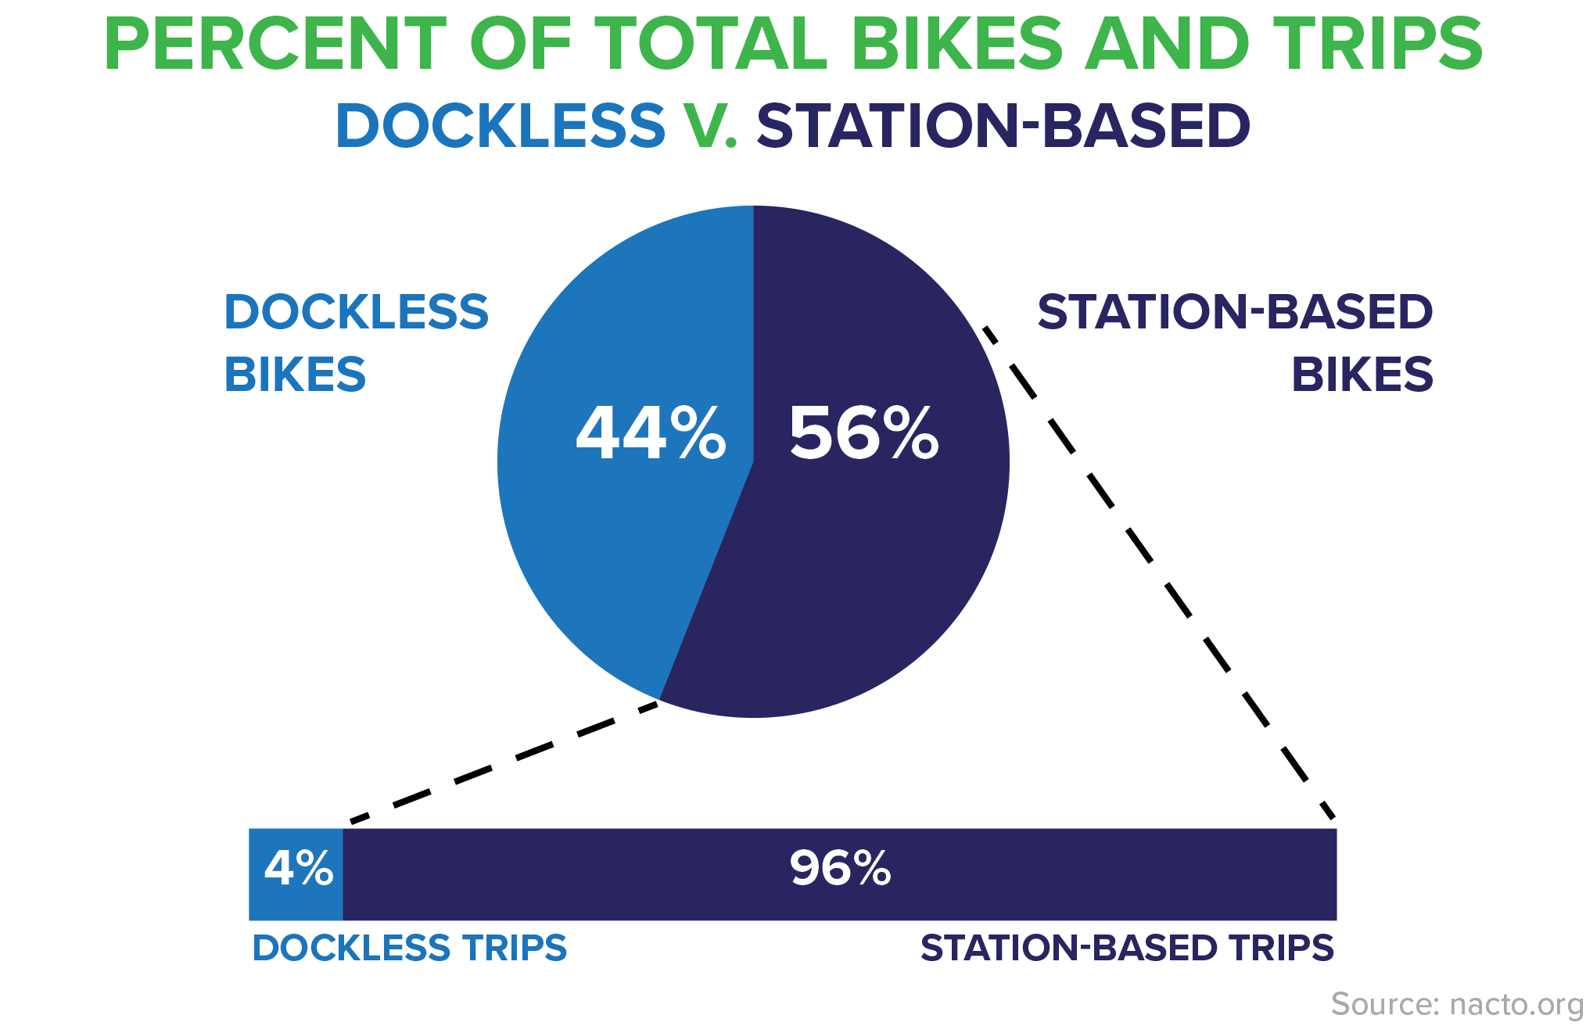

Slide 35
United States Timeline
B-Cycle
Denver, CO
2017
Dockless
Bikeshare Boom
Divvy
Chicago, IL
Capitol Bikeshare
Washington DC
Small ball
2010
2011
2012
2013
2014
2015
2016
2017
2018
2019
Nice Ride
Minneapolis, MN
Citi Bike
New York, NY
2018
Dockless
Bikeshare Bust
Citi Bike
Miami, FL
Hubway (now BLUEbikes)
Boston, MA

Slide 36
Dockless Bikeshare
Transitioning to scooters
Wave of the future!
No bikeshare stations
  Find a bike wherever
  Return wherever
Business model
  No cost to municipalities
  No corporate sponsorships required
    No lag for implementation
Lime
Out of US markets completely
Ofo
Bikeshare out of US markets completely, transitioning to scooters
Spin
?
Mobike

Slide 37
United States Timeline
B-Cycle
Denver, CO
2017
Dockless
Bikeshare Boom
2018
e-scooter BOOM
Divvy
Chicago, IL
Capitol Bikeshare
Washington DC
Small ball
2010
2011
2012
2013
2014
2015
2016
2017
2018
2019
Nice Ride
Minneapolis, MN
Citi Bike
New York, NY
2018
Dockless
Bikeshare Bust
Citi Bike
Miami, FL
Hubway (now BLUEbikes)
Boston, MA

Slide 38
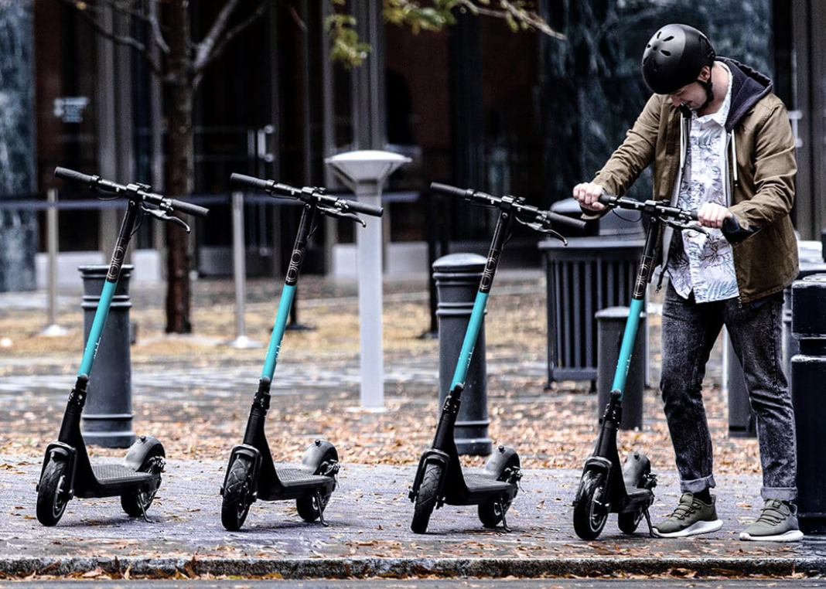
e-Scooters
Go up to 18 mph
Typically dockless
Smaller footprint

Slide 39
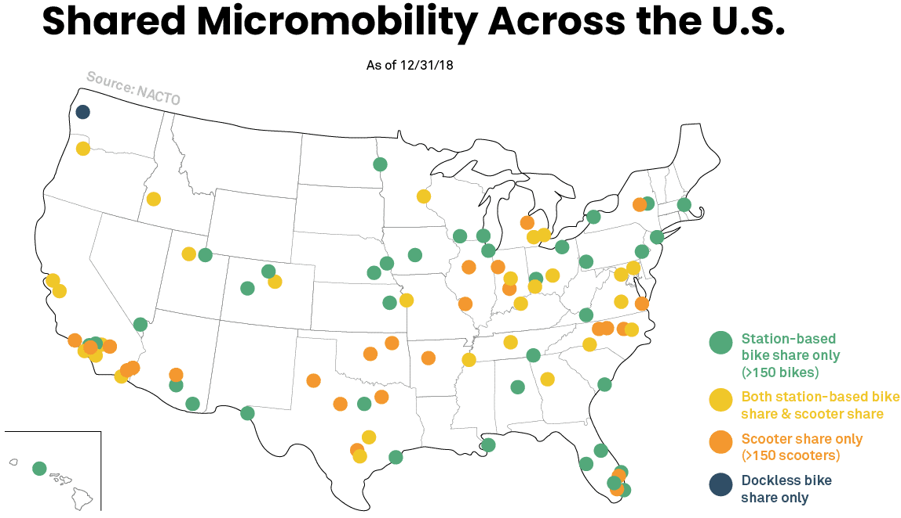
Systems Established Quickly

Slide 40
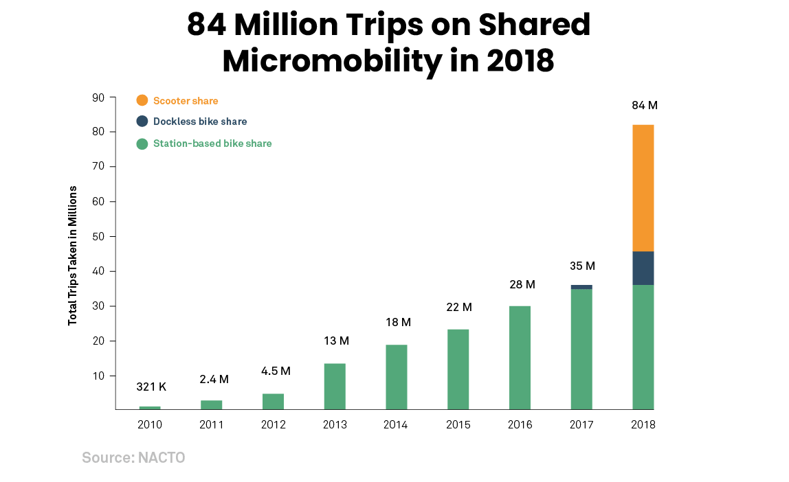
RIDERSHIP (Unlike Dockless Bikeshare)

Slide 41
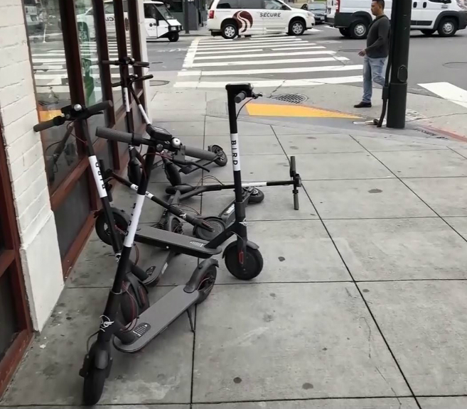
Dockless Problems Can Remain with e-Scooters
Everywhere means anywhere
Municipalities allowing several vendors
Uninvited
Pulling out without notice/permission
Funding not sustainable

Slide 42
United States Timeline
B-Cycle
Denver, CO
2017
Dockless
Bikeshare Boom
2018
e-scooter BOOM
Divvy
Chicago, IL
Capitol Bikeshare
Washington DC
Small ball
2010
2011
2012
2013
2014
2015
2016
2017
2018
2019
Nice Ride
Minneapolis, MN
2018
e-bike boom
Citi Bike
New York, NY
2018
Dockless
Bikeshare Bust
Citi Bike
Miami, FL
Hubway (now BLUEbikes)
Boston, MA

Slide 43
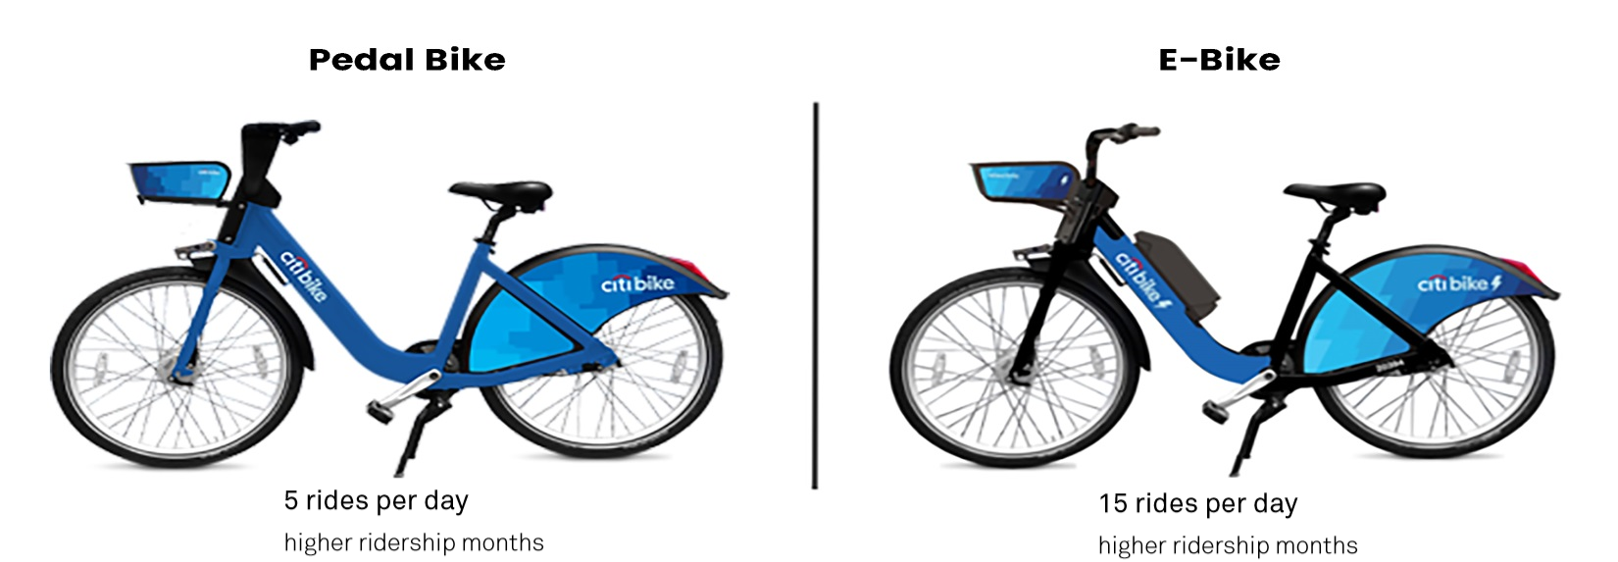
Pedal-Assist Bike
Removes barriers
  Physical fitness
  Sweat-free
Fun!
Greater Ridership

Slide 44
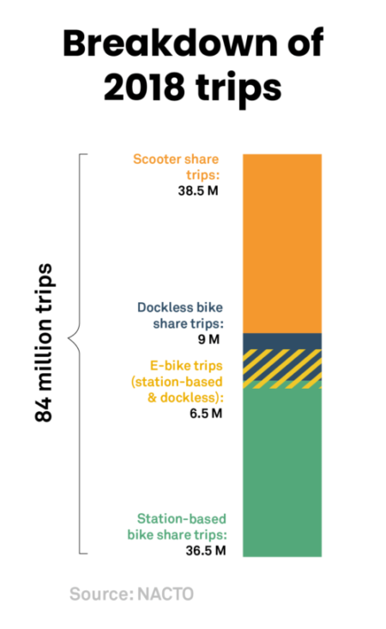
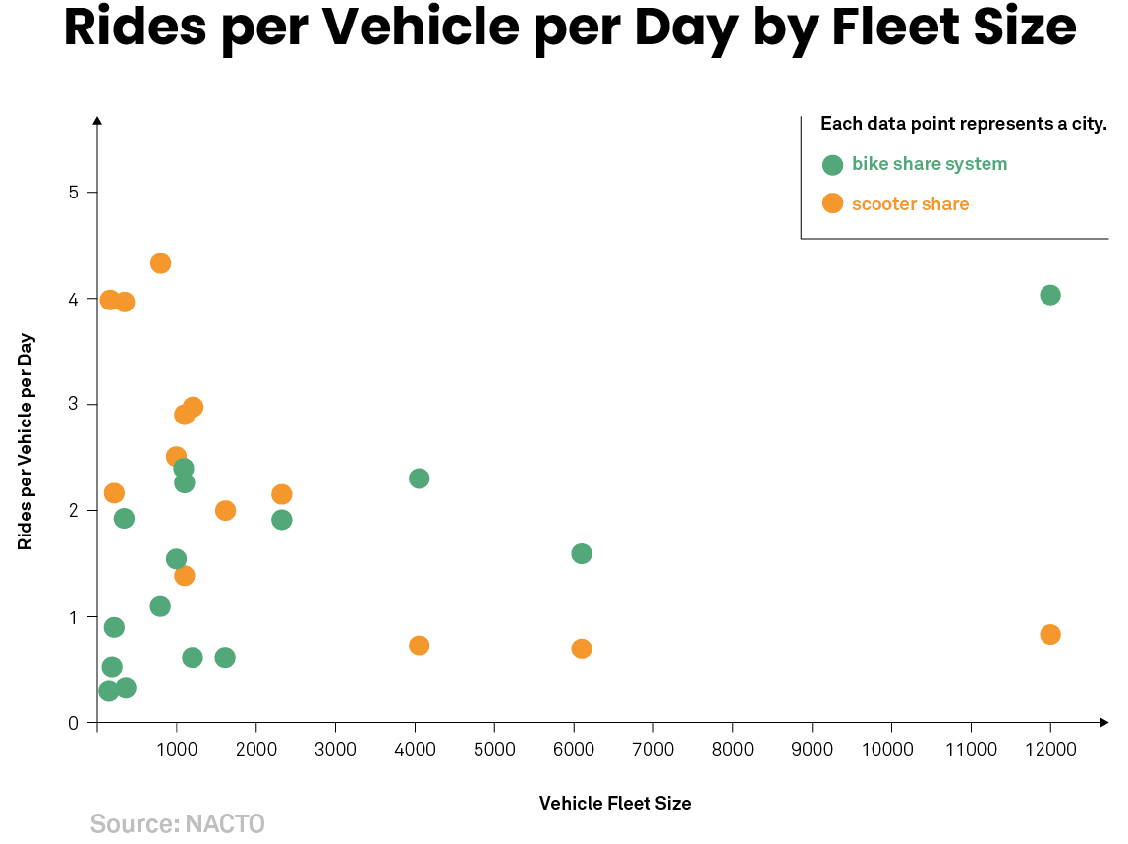

Slide 45
Arkansas and shared mobility

Slide 46
Arkansas Timeline
Mule Rides
SAU – Magnolia
Gotcha smart bikeshare
Feb. 2019-
Fayetteville Bikeshare
VeoRide – dockless bikeshare
Sept. 2018-
VeoRide
dockless bikeshare
UA Little Rock
Nov. 2018-
Gotcha
Smart Bikeshare
North Little Rock
June 2019
ASU – Jonesboro
VeoRide – dockless bikeshare
Aug. 2018-
Gotcha/Bantam
Smart Bikeshare
Little Rock
Fall 2019
2017
2018
2019
Bird e-scooters
Arkansas Tech - Russellville
Sept.-Dec. 2018
Lime dockless bikeshare
ASU - Jonesboro
October 2017-July 2018
SPIN dockless bikeshare
UALR
Feb.-Aug. 2018
Lime e-Scooters
Little Rock
Dec. 2018-Sept. 2019

Slide 47
Why Shared Micromobility?
Economic Vitality – Millennials
Transportation equity
Parking
Sustainability
Public health

Slide 48
Is bikeshare/e-scooters right for my arkansas community?
and if so, what type of system?

Slide 49
What are you trying to solve?
Transportation equity?
Health?
Fun/Livable Community?
Sustainability?

Slide 51
Differences among Equipment

Slide 52
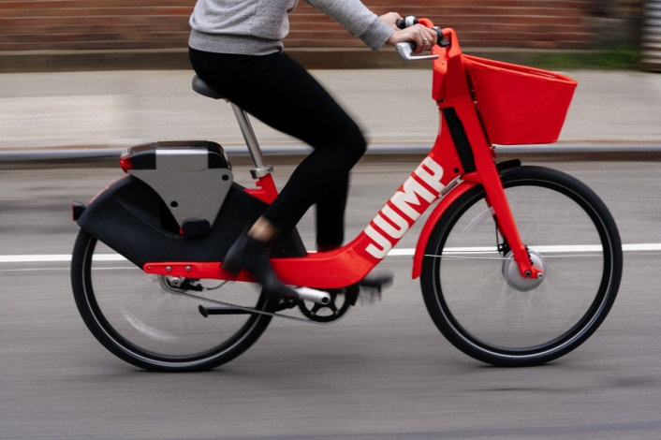
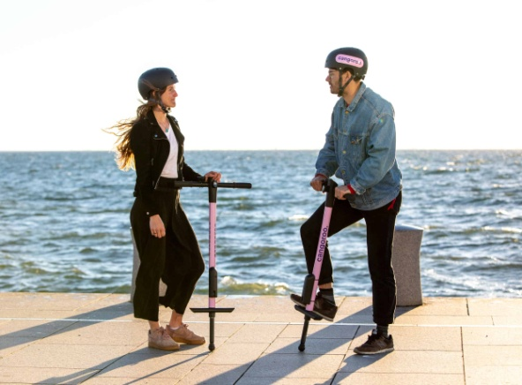
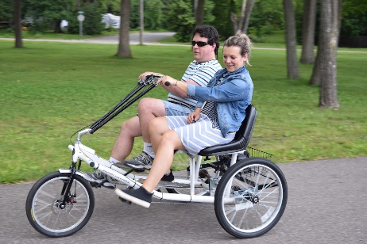
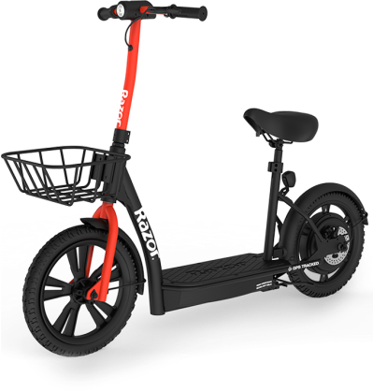
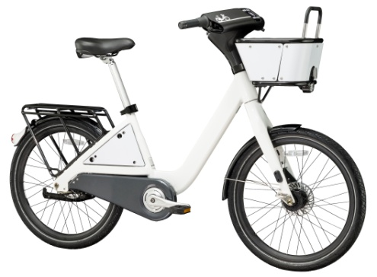
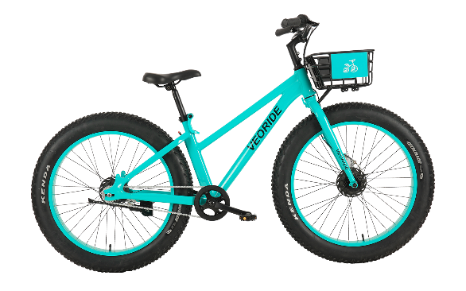
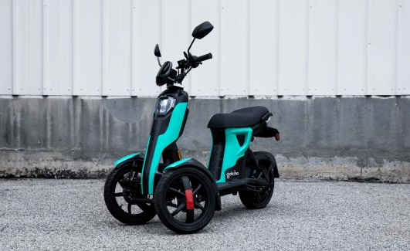
What Equipment is Right for You?
Pedal-assist bikes
e-Scooters
Pogo Sticks
Two-person
Sit Scooters
Traditional bikes
Fat tire bikes
Trikes
Want wide usage, low learning curve

Slide 53
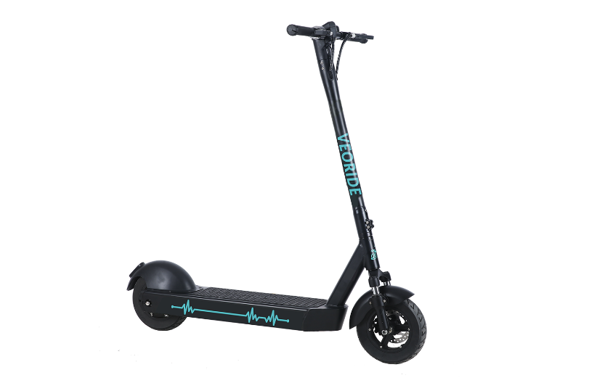
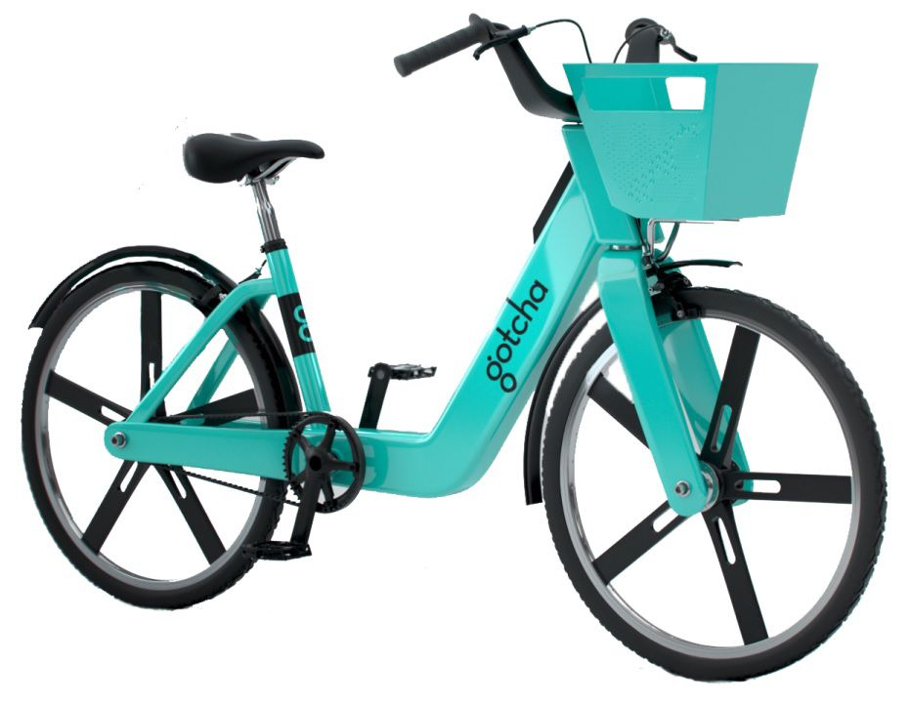
What Equipment is Right for You?
Bikes
e-Scooters
More established
Users know where to ride them more intuitively
Used for longer trips
Easier to find docked option
A LOT of use in 2018/2019
Smaller parking footprint
Easier to find smaller town or campus provider?

Slide 54
What Equipment Right for You?
Docked
Dockless
Orderly
Distributed predictably
More easily managed
  Fewer parking complaints
  Easier to swap batteries
Less disruption
Requires fewer units to function
Can expand bike parking
Greater immediate coverage area
Distributes on-demand in real-time
More immediate equity solution

Slide 55

What Equipment Right for You?
Traditional Bike
Pedal-Assist
Equipment cheaper
Operations cheaper
  No staff required to swap and charge batteries
User fees cheaper
Fewer barriers to use
  Less physically fit
  Don’t overheat
Better for hills
Used 2-3x as much
Fun!
Less intimidating to ride with traffic

Slide 56

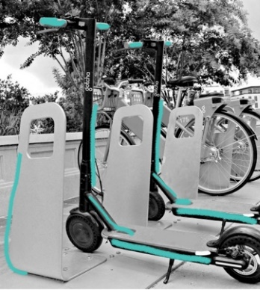
Multiple Platforms?
One Platform
Multiple Platforms
Less space
Smaller user learning curve
Less effort for municipality or campus?
May attract more micromobility use overall
Hedge bet
  Phase into one platform or the other depending on local demand

Slide 57
Differences among vendors

Slide 58
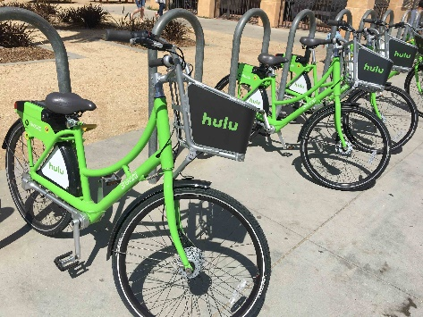

Multiple Vendors?
Single Vendor
Multiple Vendors
RPF
Less equipment
  Competition incentivizes each vendor to dump many units onto City sidewalks
  Externalizes the cost of clutter to City
One app for users
Fewer entities for City to handle
  Fewer contracts
  Fewer data sharing platforms
  Fewer vendors with whom to manage complaints
Especially important if multiple platforms
RFQ
Hedge bet
  One vendor doesn’t work out, pulls out of City, goes out of business, other vendors in place to continue micromobility uninterrupted
I would strongly recommend a single, exclusive vendor

Slide 59
Dockless Vs. Partnership

Slide 60
Business Practices
Who invited you?
  Dropping 100’s of bikes in Cities without their knowledge or permission
  Fighting to stay when Cities want them gone
Funding not sustainable
  Incentive to plant flag in markets to be sold for market share
  Selling data
Whose system is this
  Systems being removed from communities without their prior knowledge or consent

Slide 61
Advice
Don’t discount the value of your ROW
Consider transportation system
  Would these need to be ridden on state highways
Consider micromobility parking
Consider public perception
Talk to an expert
Municipal staff capabilities
Don’t open the door too widely

Slide 62
Questions?

